Slide 1
JAVA PROJECTS
HARMANJIT SINGH
1710991290
CSE-K1

Slide 2
OBJECTIVES
The main objective of ONLINE QUIZ is to efficiently evaluate the candidate thoroughly through a fully automated system that not only saves lot of time but also gives fast results.

Slide 3
FEATURES
1) In comparison to the present system the proposed project will be less time consuming and less time consuming and is more efficient.
2) Result will be very precise and accurate and will be declared in very short span of time.
3)The purposed project is very secure as no chances of leakage of quiz as it is dependant on the administrator only.

Slide 4
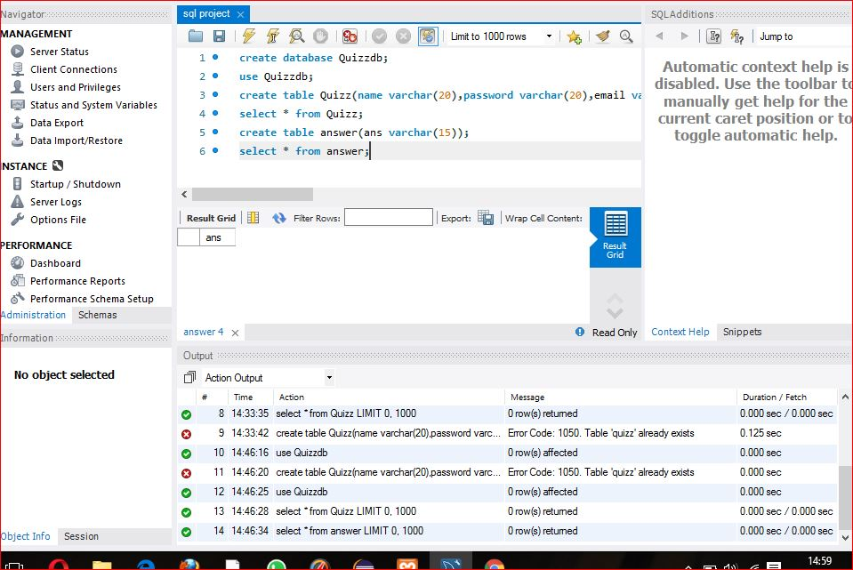
DATABASE

Slide 5
CODE
package hello;
import java.sql.*;
import java.util.*;
public class Quizz {
public static void main(String[] args) {
try {
Scanner sc =new Scanner(System.in);
String name,password,email,clas;
System.out.println("Press 1 for signup");
System.out.println("Press 2 for login");
System.out.println("Press 3 for taking quiz");
Class.forName("com.mysql.jdbc.Driver");
Connection conn=DriverManager.getConnection("jdbc:mysql://localhost/Quizzdb","root","");
Statement stmt=conn.createStatement();
int a;
String [] ans =new String[4];
String [] input =new String[4];
int marks=0;
a=sc.nextInt();
switch(a)
{

Slide 6
case 1:
{
System.out.println("Enter name");
name=sc.next();
System.out.println("Enter password");
password=sc.next();
System.out.println("Enter email");
email=sc.next();
System.out.println("Enter class");
clas=sc.next();
String q="insert into quiz values('"+name+"','"+password+"','"+email+"','"+clas+"');";
stmt.execute(q);
break;
}
case 2:{System.out.println("Enter name");
name=sc.next();
int u=0;
String h1="select * from quiz;";
ResultSet pointer1=stmt.executeQuery(h1);
while(pointer1.next())
{
if(name.equals(pointer1.getString(1)))
{
u++;
}
}
if(u==0)
{
System.out.println("You are not registered");
}
if(u>0)
{
System.out.println("enter password");
password=sc.next();
String q="select password from quiz where name='"+name+"';";

Slide 7
ResultSet point=stmt.executeQuery(q);
System.out.println(point.getString(1));
String c1=point.getString(1);
if(password.equals(c1))
{
System.out.println("logged iN");
}
else
{
System.out.println("Wrong password");
}
}
break;
}
case 3:
{
System.out.println(" Q1 .How many planets are there in solar system?");
input[0]=sc.next();
ans[0]="eight";
System.out.println("Q2 . How many moon does earth have?");
input[1]=sc.next();
ans[1]="one";
System.out.println("Q3 .What is position of our planet earth in solar system?");
input[2]=sc.next();

Slide 8
ans[2]="third";
System.out.println("Q4 .Which is the largest planet?");
input[3]=sc.next();
ans[3]="jupiter";
System.out.println("Q5 .Which is the coldest planet?");
input[4]=sc.next();
ans[4]="neptune";
for(String h:ans)
{
String j="insert into answer values('"+h+"');";
stmt.execute(j);
}
String k="select ans from answer;";
ResultSet pointer2=stmt.executeQuery(k);
int l=0,i=1;
while(pointer2.next() && l<4) {
if(input[l].equals(pointer2.getString(1)))
{
marks++;
}
l++;
}
System.out.println("you scored "+marks);
}
} }
catch(Exception e)
{
e.printStackTrace();
} }
}

Slide 9
PROJECT 2

Slide 10
OBJECTIVES
The main objective of the Blood Bank Management System is to manage the details of Blood ,Donor,Blood Group,Blood Bank,Stock.The purpose of the project is to build an application program to reduce the manual work for managing the Blood,Donor,Blood Cell,Blood Group.

Slide 11
FEATURES
1) Provides the facilities based on various factors such as blood donors , different blood groups details,etc.
2) Blood Bank Management System also manage the blood bank corruption free,insurance registration and expiration details.
3) Manage the information of donors.
4) Shows the information and description of the blood bank employee.
5) It deals with monitoring the information blood type , storage area etc.

Slide 12
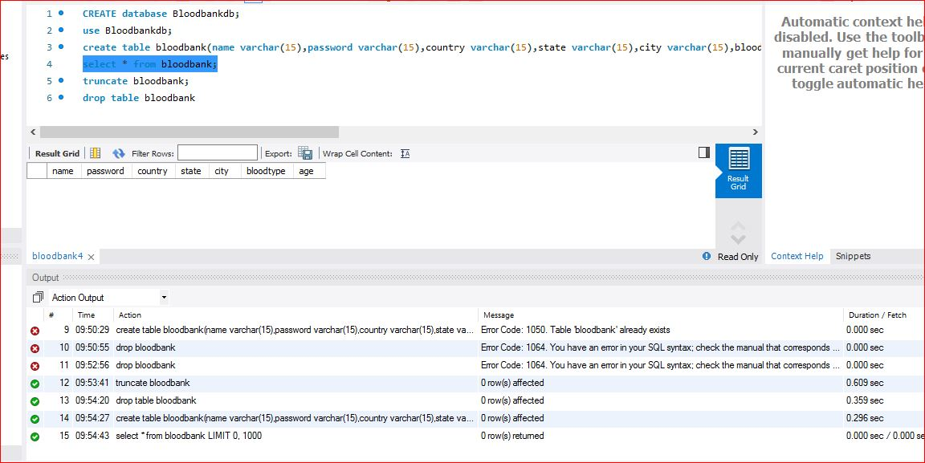
DATABASE

Slide 13
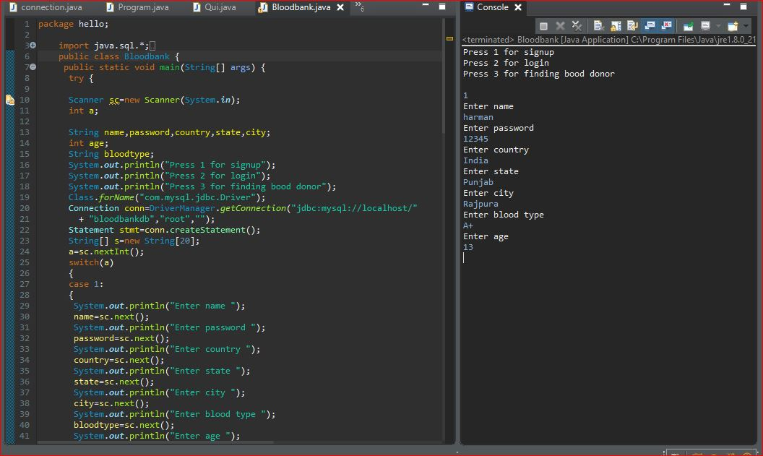
CODE

Slide 14
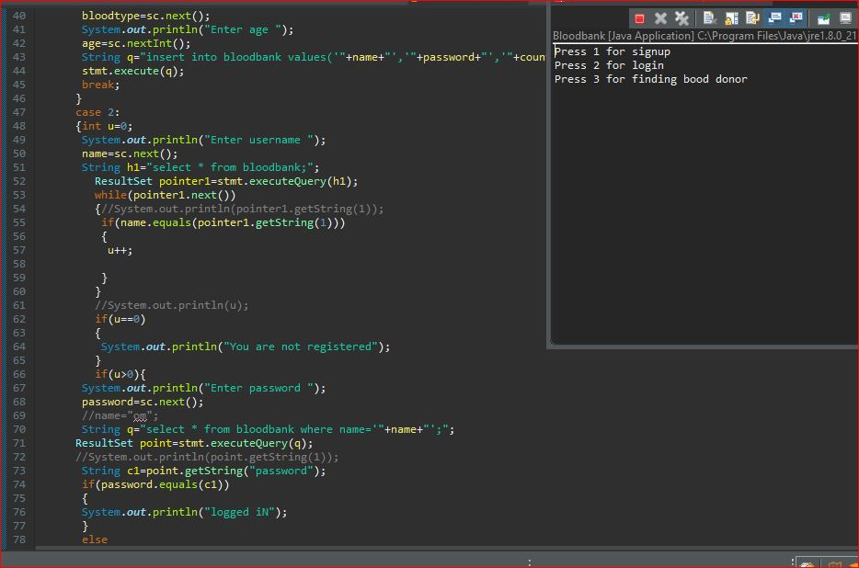

Slide 15
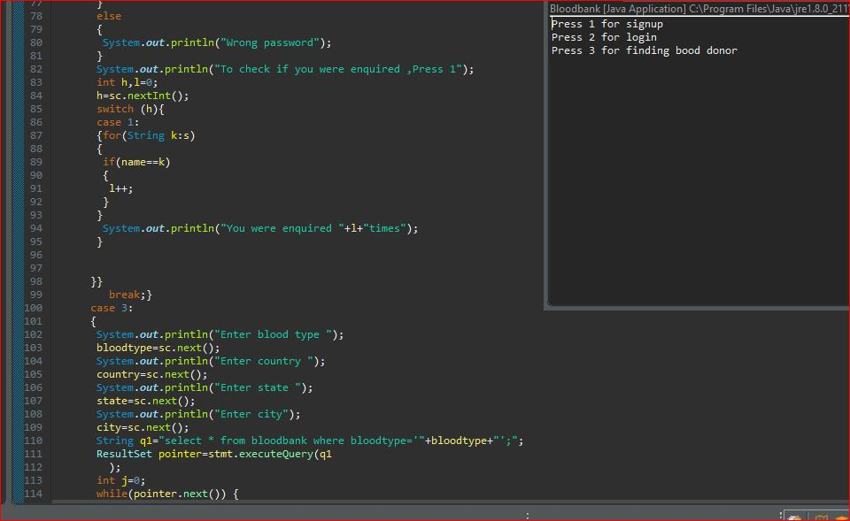

Slide 16
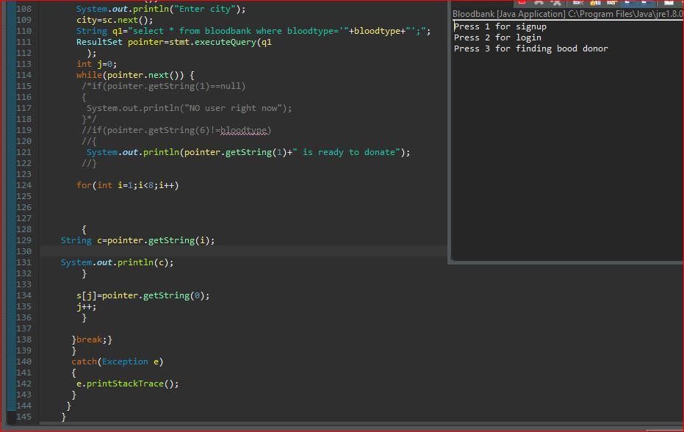

Slide 17
PROJECT 3

Slide 18
OBJECTIVES
The main objective of date/time schedule is that: The Date represents a specific instant in time , with millisecond precision . It implements Serializable and Comparable Interface . It provides constructors and methods to deal with date and time with java.
Date() : Creates date object representing current date and time.

Slide 19
FEATURES
1) It will show the correct date and time when displayed on the screen.
2) Manage the information of date when displayed on the screen.
3) Manage the information of time when displayed on the screen.

Slide 20
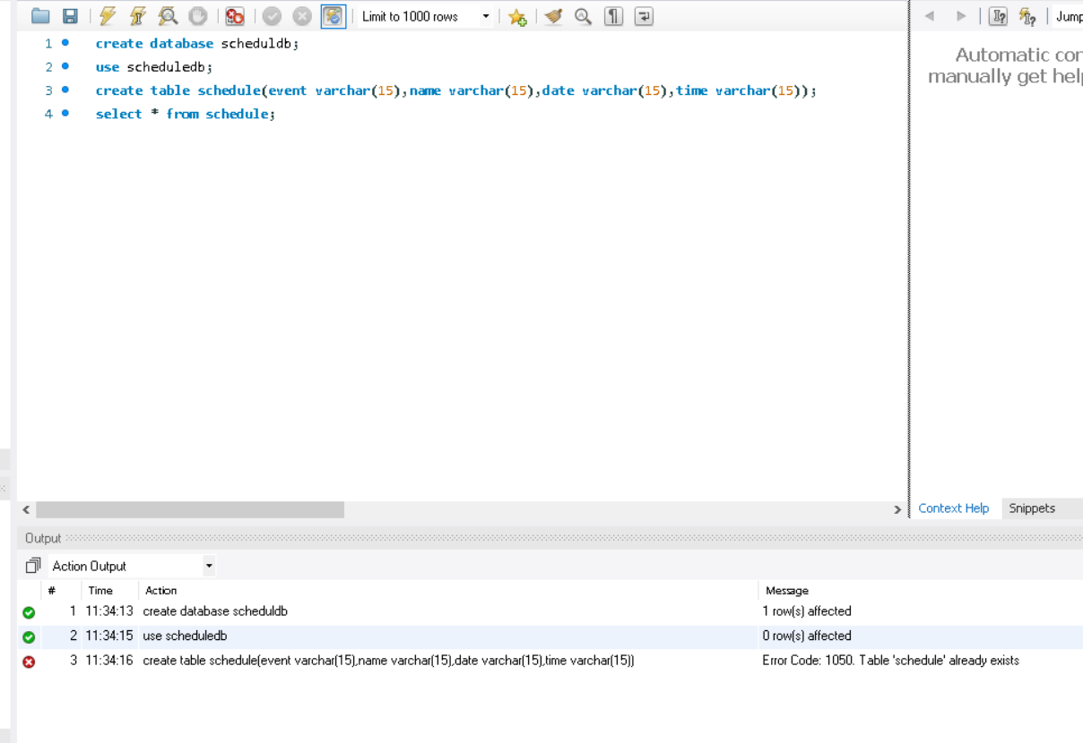
DATABASE

Slide 21
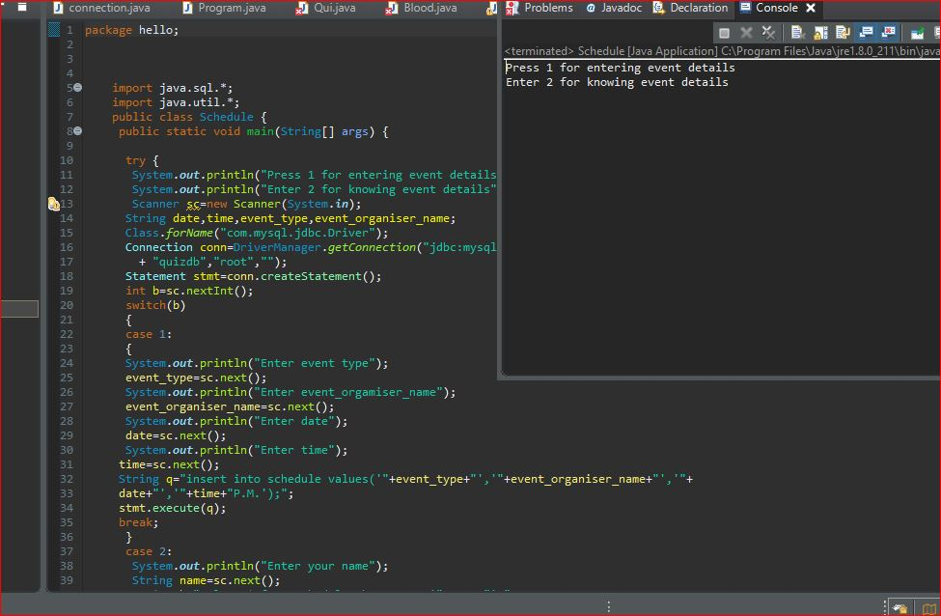
CODE

Slide 22
